Slide 1
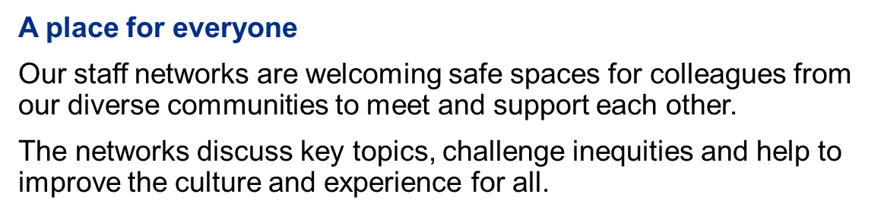
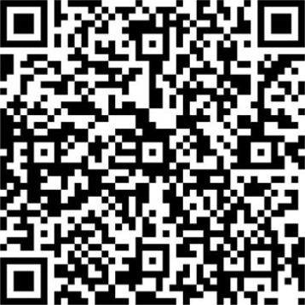
Lead change
Who can join a network as a member?
Anyone who identifies as part of a community is welcome to join that Network as a member.
Who can join a network as an ally?
An ally is anyone who does not identify as part of a community but wishes to listen, learn, and actively support a network.
Join a staff network
Scan the QR code or search
‘Staff Networks’ on the intranet
to find out more and sign up
Women’s Network
Men’s Network
LGBTQ+ Network
REACH (Race, Ethnicity
And Cultural Heritage) Network
Enable Network
Armed Forces Network

